Slide 1
An Object of Wonder in an Offensive Tee-shirt
Reflections on being the First Ordained, Accredited, Woman Minister in Sole Pastoral Charge of a Baptist Church in Scotland

Slide 2
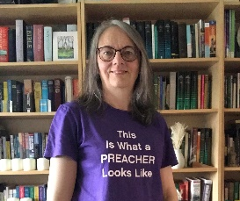

Slide 3
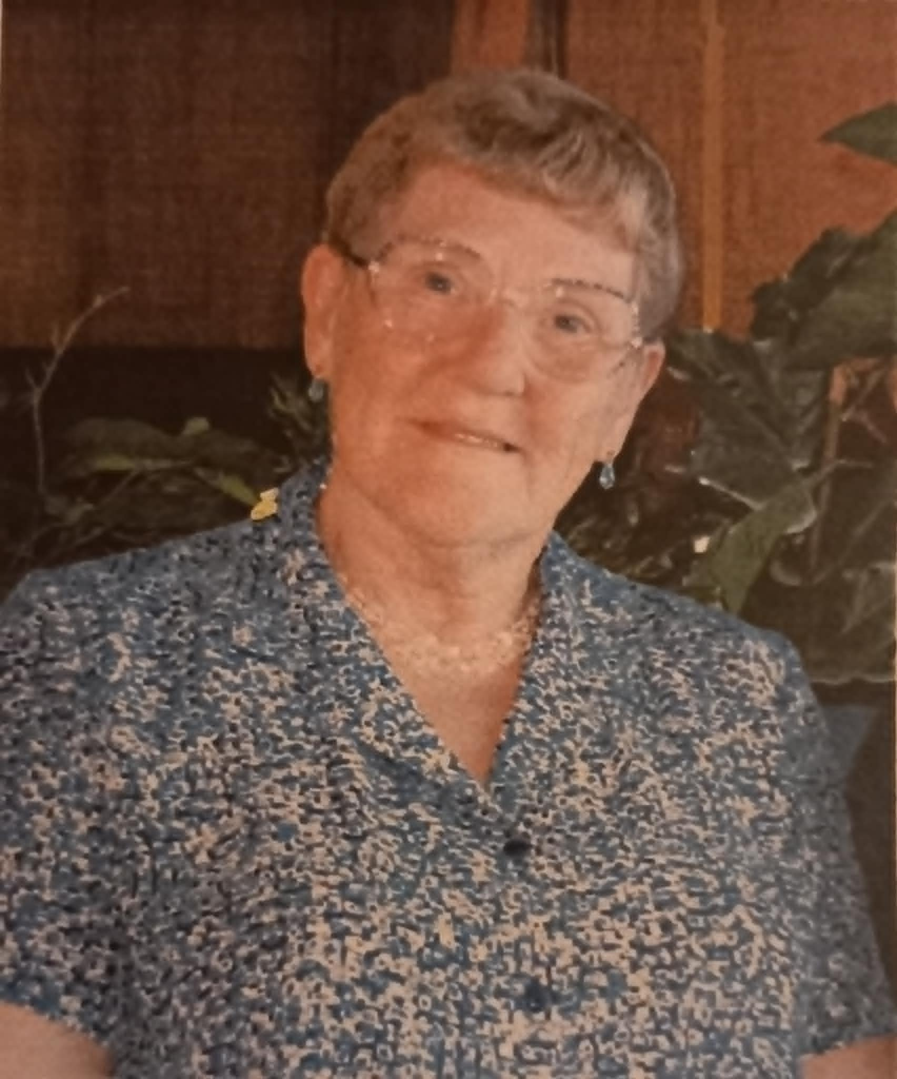
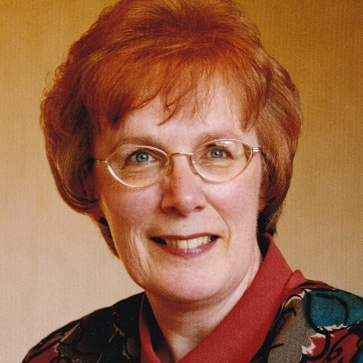
Reverend (Elizabeth) Beth Dunlop
Reverend Marjorie Taylor

Slide 4
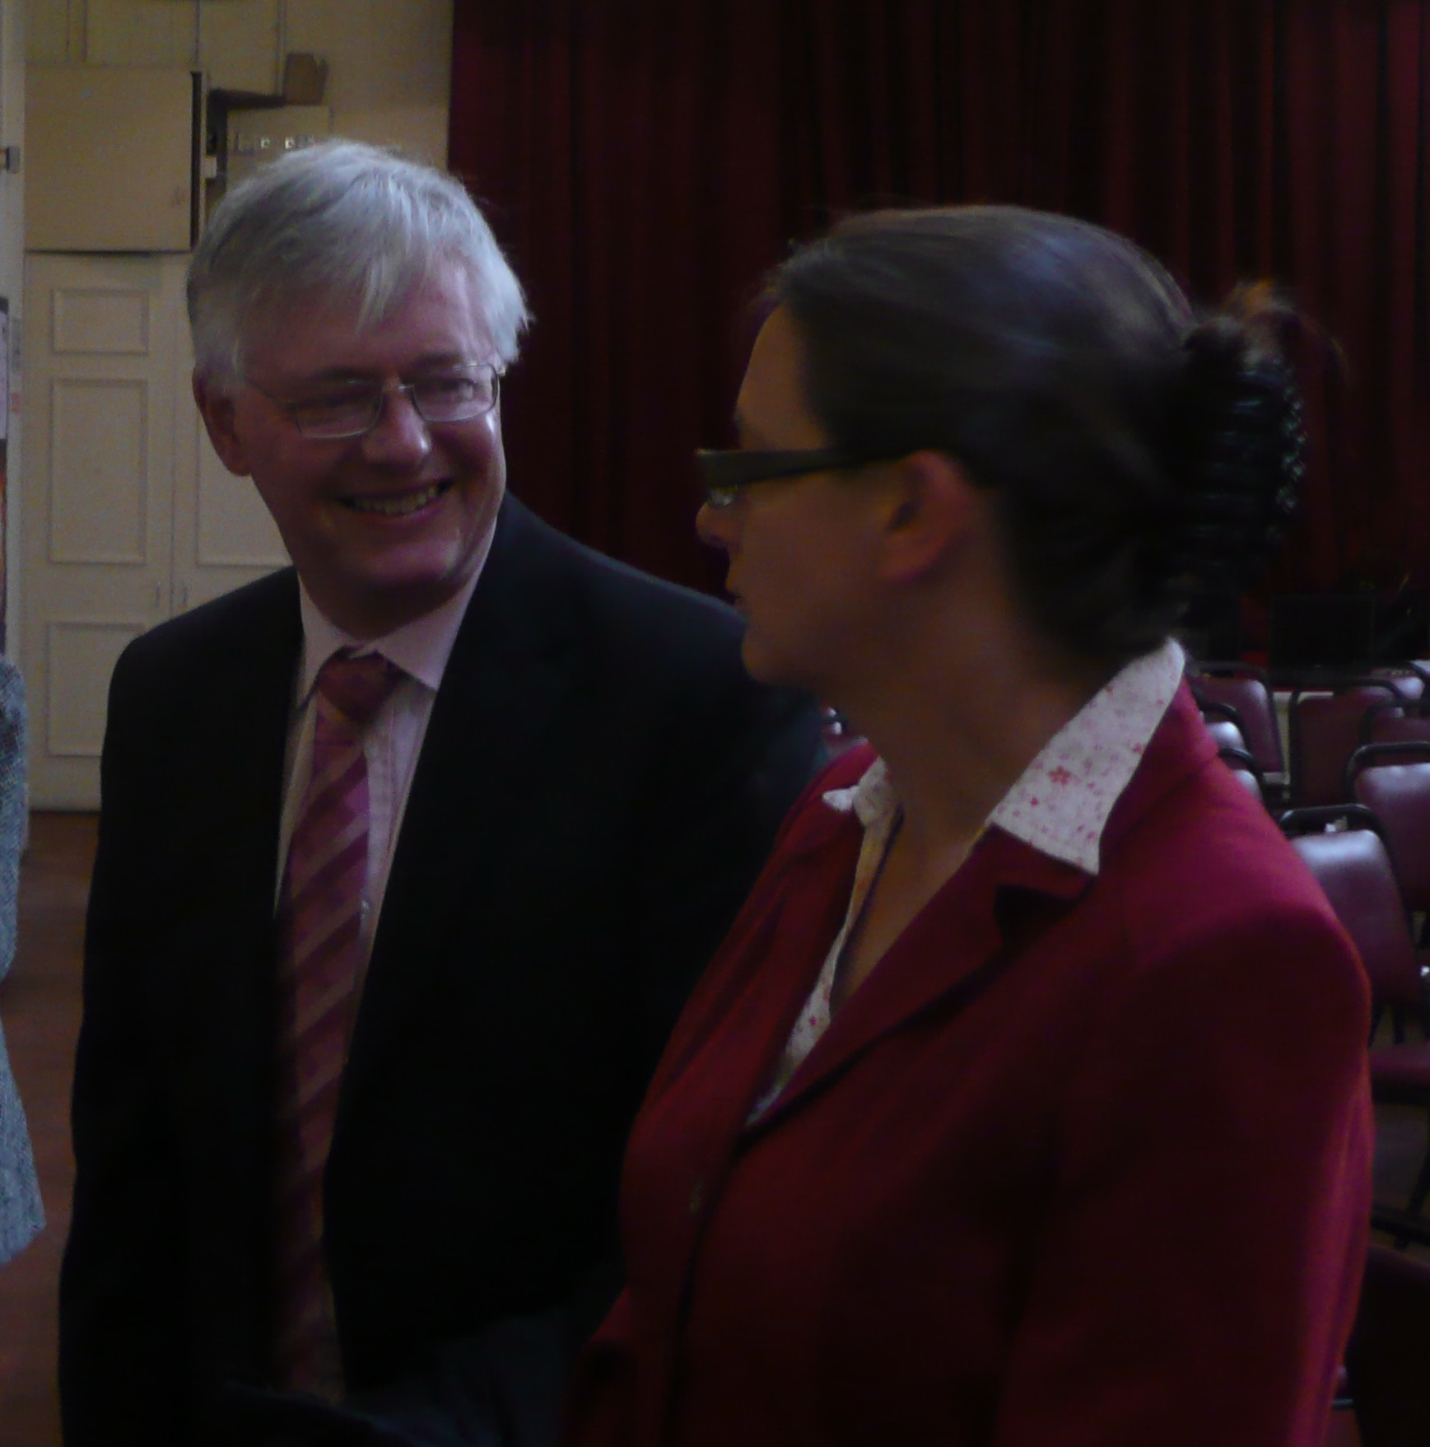
An Object of Wonder…
Photo:
With Reverend Andrew Rollinson at Induction to Hillhead Baptist Church

Slide 5
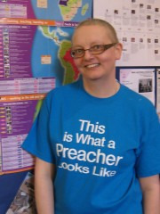
An Offensive Tee-shirt…
Photo:
Wearing the “offensive” tee-shirt, Hillhead Baptist Church, spring 2011

Slide 6
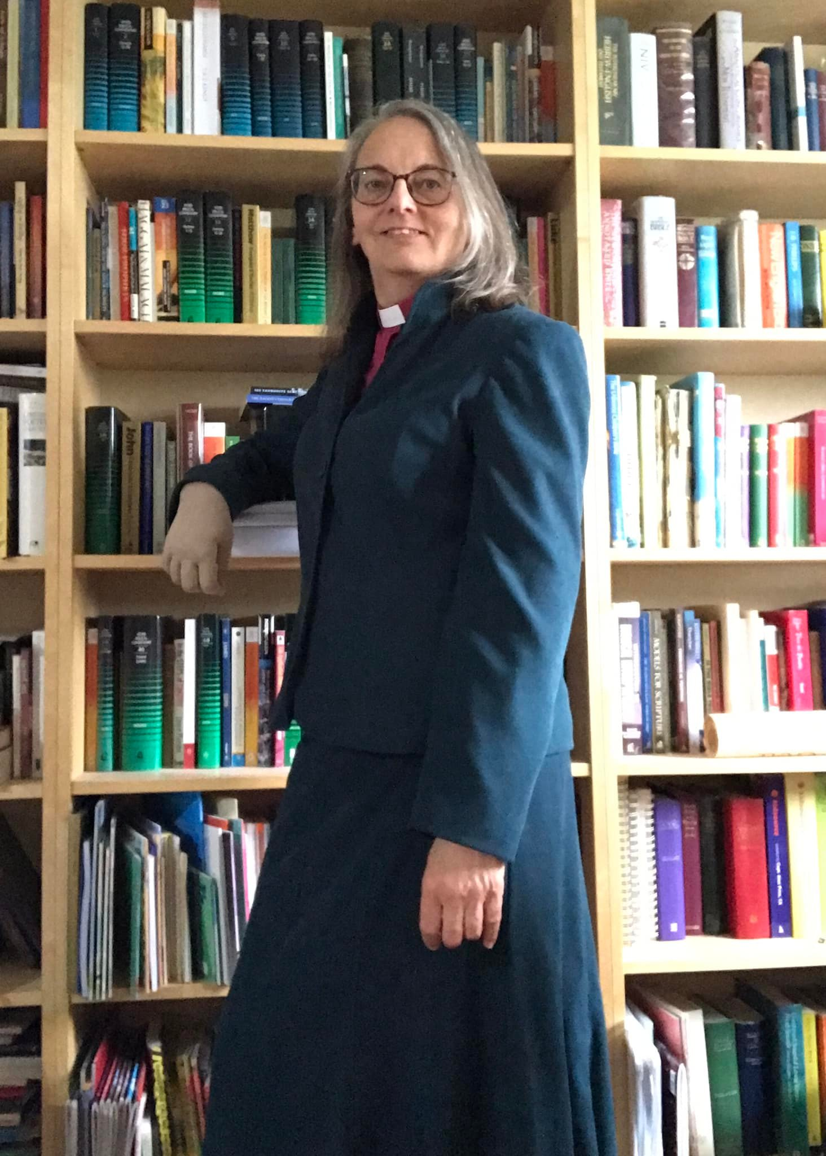
An Obstreperous Theology of Hope…
Photo:
Final week at Hillhead Baptist Church
– ready to conduct a wedding

Slide 7
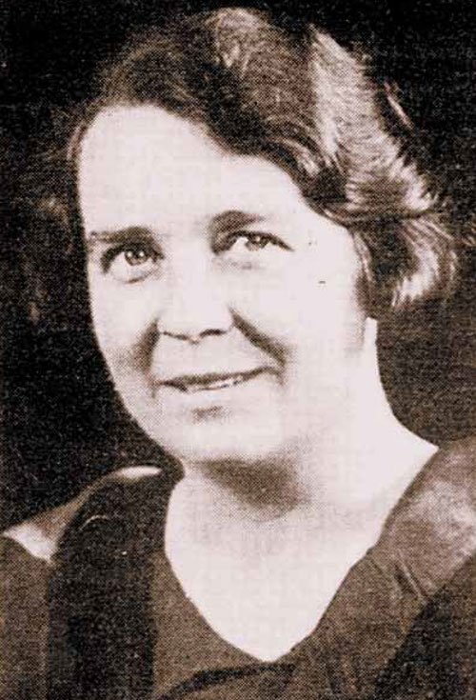
A Lament or Rant…

