Slide 1
We will work for them, as long as our brain can think, and our pen can write, and our heart can love.
~ Charles Spurgeon

Slide 2
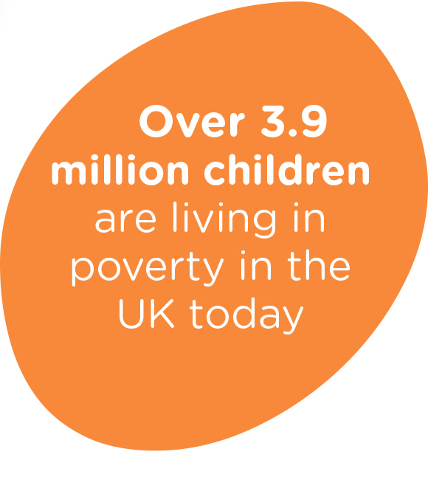
Spurgeons Children’s Charity – 150 years of hope for every child
In 1867, Baptist preacher Charles Haddon Spurgeon, driven by a desire to tackle poverty and injustice, founded an orphanage. Armed with a pen, he encouraged people to open their doors and hearts to the most vulnerable children.
150-years on, we are still very much at the heart of communities, continuing his mission to give every child the opportunity and hope of a better life. Although the face of our work has changed, the need is just as great today as it was then.

Slide 3
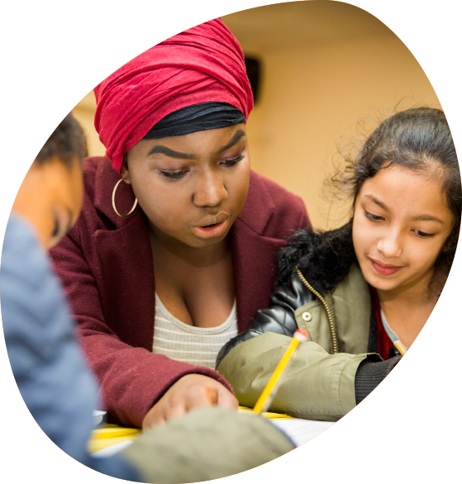
A practical response to his heartfelt mission
Charles Spurgeon was England’s best-known Baptist preacher. At 20 years old he became pastor of London’s famed New Park Street Church. As well as his preaching, he was passionate about helping disadvantaged street children. Spurgeons Children’s Charity was founded in 1867 when Anne Hillyard donated £20,000 to Charles Spurgeon, to be used to open an orphanage for boys.
As a result Stockwell Orphanage opened in 1869. 10 years later, it was opened to girls and by the time the girls' dormitories were complete, over 500 children were living there.

Slide 4
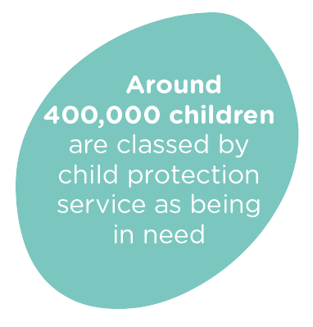
Charles Spurgeon’s legacy and our work today
Today Spurgeons reaches out to 37,000 children and young people and over 64,000 parents and carers. Guided by our Christian faith, we believe every child deserves the opportunity of living a happy and hope filled life: that no child should face abuse, neglect or uncertainty.
Through the delivery of support and intervention services, and by speaking up on behalf of those who need us most, we give vulnerable children and families the chance they need.

Slide 5
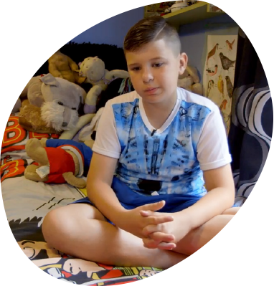
Helping children like Archie
“I was bullied at school because I’m different from other people who don’t understand about being a young carer - they laugh at me sometimes. But my support workers from Spurgeons look after me and don’t laugh at me like the kids at school.” Archie
Archie is 11-years-old and cares for his mum Sue who suffers with Fibromyalgia. Spurgeons is a life line for both mum and son. We support Archie by providing space for him to be with young carers like himself and we provide a listening ear for mum Sue when things get too much.

Slide 6
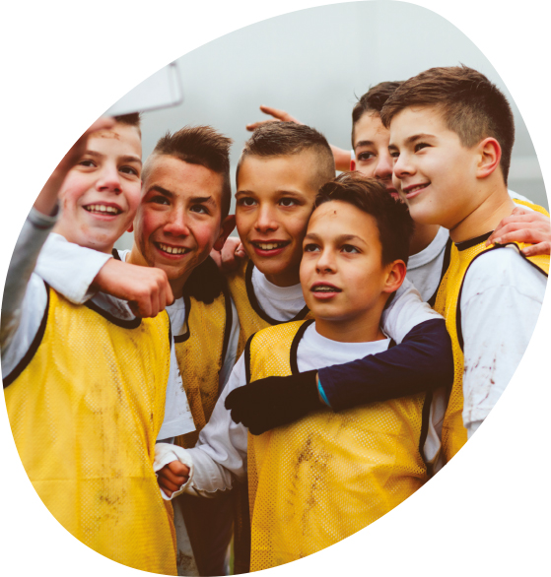
Working together
Spurgeons Children’s Charity and Baptists Together have put together a special devotional to celebrate the life and work of Charles Spurgeon.
We hope this will inspire you to join us in continuing his mission and help us give hope to every child.
To find out more about our work with children like Archie, and the support we give other vulnerable children and families across England, visit our website: www.spurgeons.org or call us on 01933 417435.

