Slide 1
www.renewwellbeing.org.uk

Slide 2
The cup of my life

Slide 3
what is wellbeing?

Slide 4
quiet shared spaces
where it’s ok not to be ok
“An end to isolation
and better mental health for all.”

Slide 5
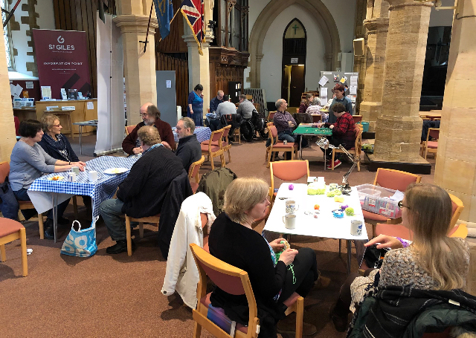

Slide 6
Being present
In what ways are you/ your church being present in your community?
How is this working for folk with mental ill health?

Slide 7
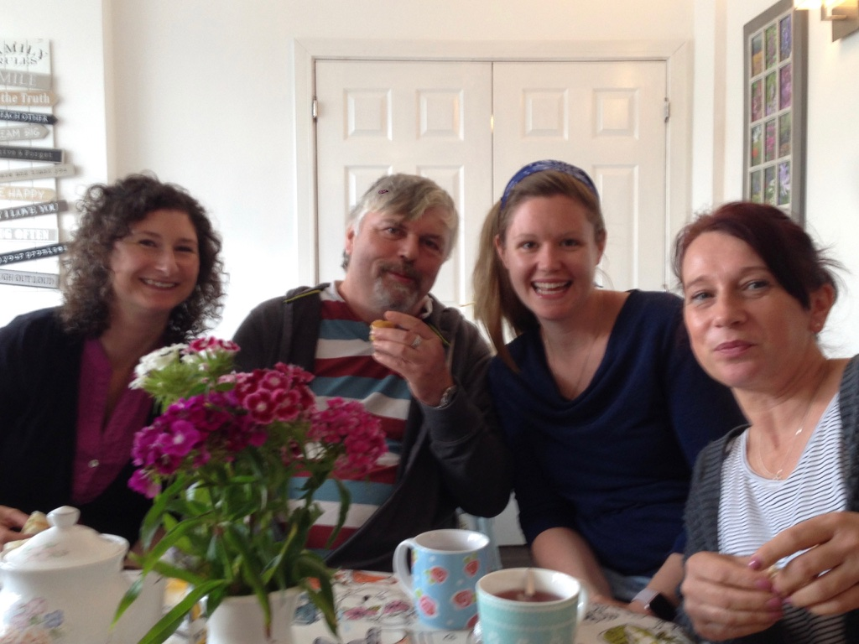
being in partnership

Slide 8
Being in partnership which people of peace are you working with? Any good relationships with the mental health team in your area ?

Slide 9
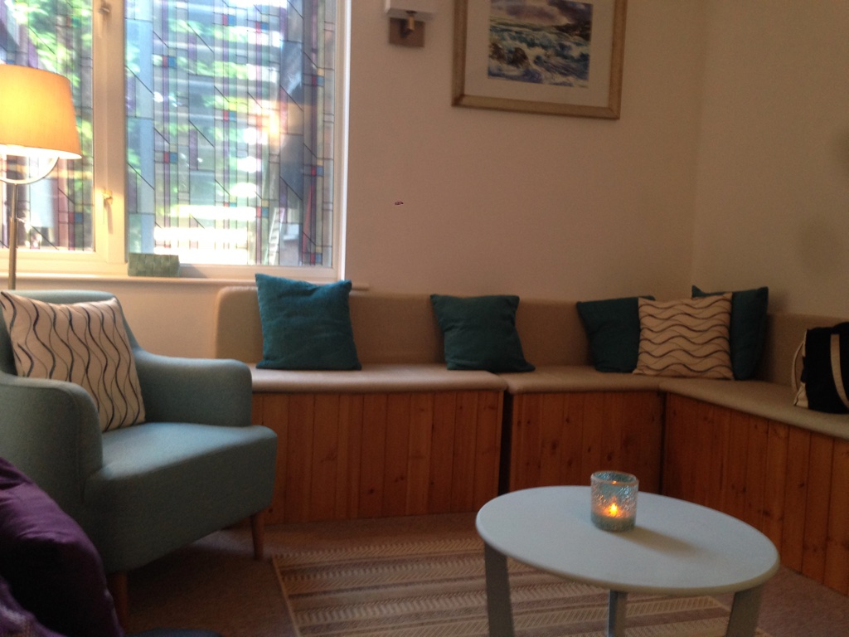
being prayerful

Slide 10
Being prayerful
What habits of prayer help you with your wellbeing?
Do you have any habits you could share with your friends/ neighbours?

Slide 11
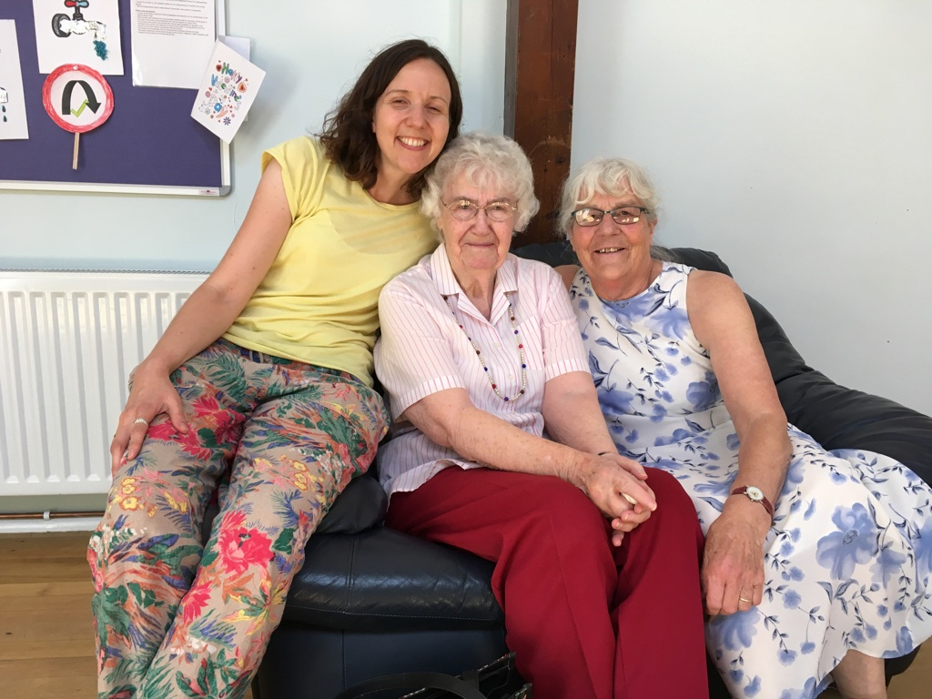
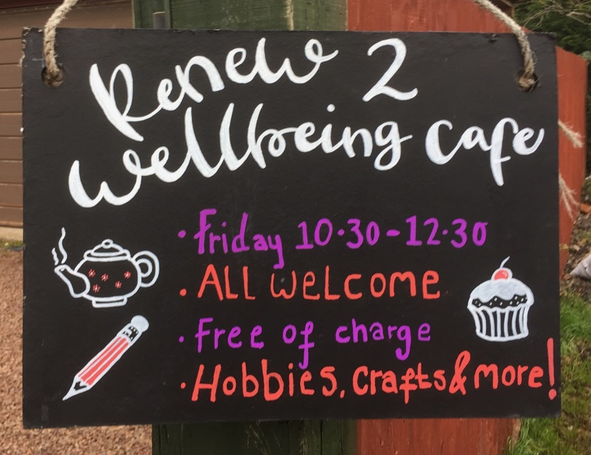
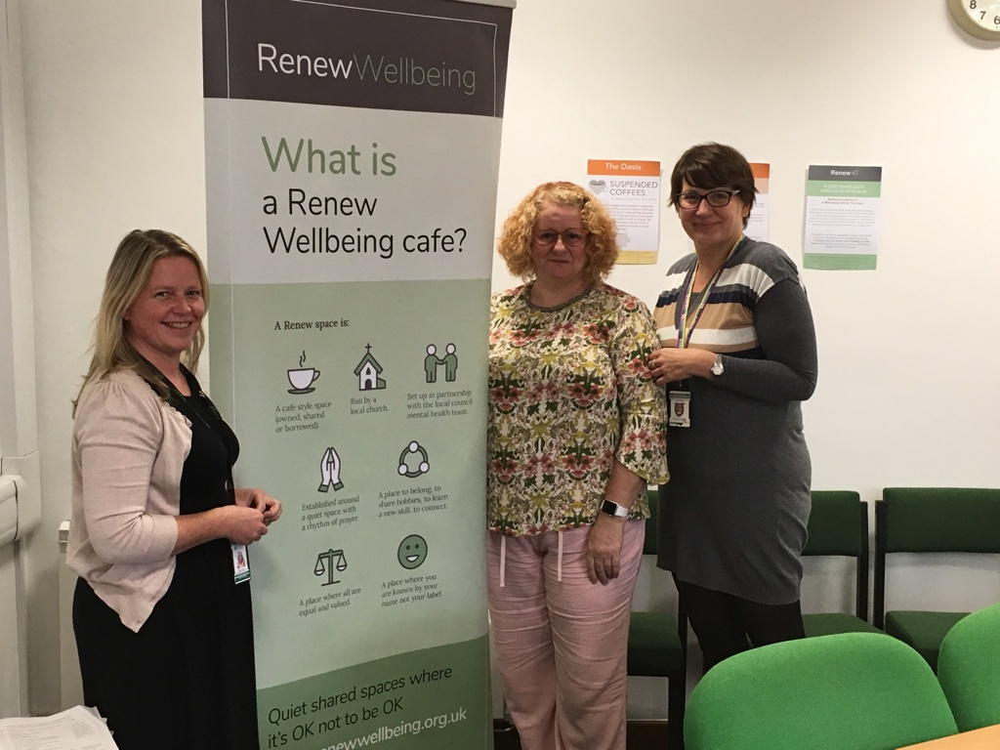
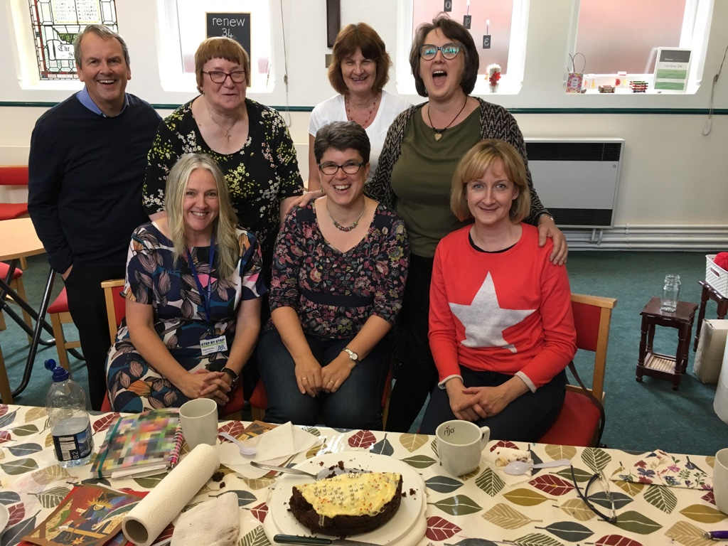

Slide 12
next steps
CONNECT.. www.renewwellbeing.org.uk
LEARN… join a webinar and register to do training
GET ACTIVE… Do the 3 session training course
TAKE NOTICE…reflect and make a plan in a zoom meeting with our area co ordinator
GIVE…. become part of the Renew family. Get started being present , prayerful and in partnership.

